Slide 1
Checking and securing understanding of plotting coordinates
Graphical representations of linear equations

Slide 2
how to use Oak lessons

Slide 3
I can plot coordinates in any of the four quadrants.

Slide 4
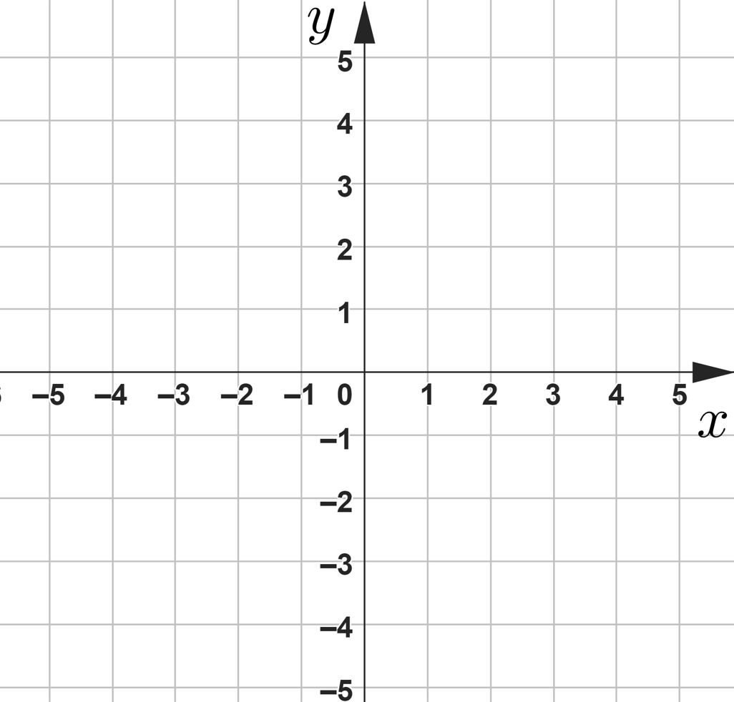
A quadrant is any one of the four areas into which a space is divided by the x and y axes in the Cartesian coordinate system.
Second quadrant
First quadrant
Third quadrant
Fourth quadrant

Slide 5

Checking and securing understanding of plotting coordinates
Plotting coordinates in all four quadrants
Coordinate problem solving with shapes

Slide 6

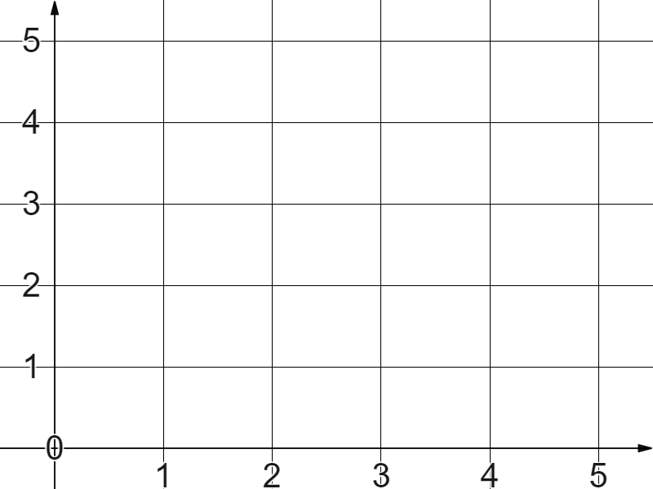
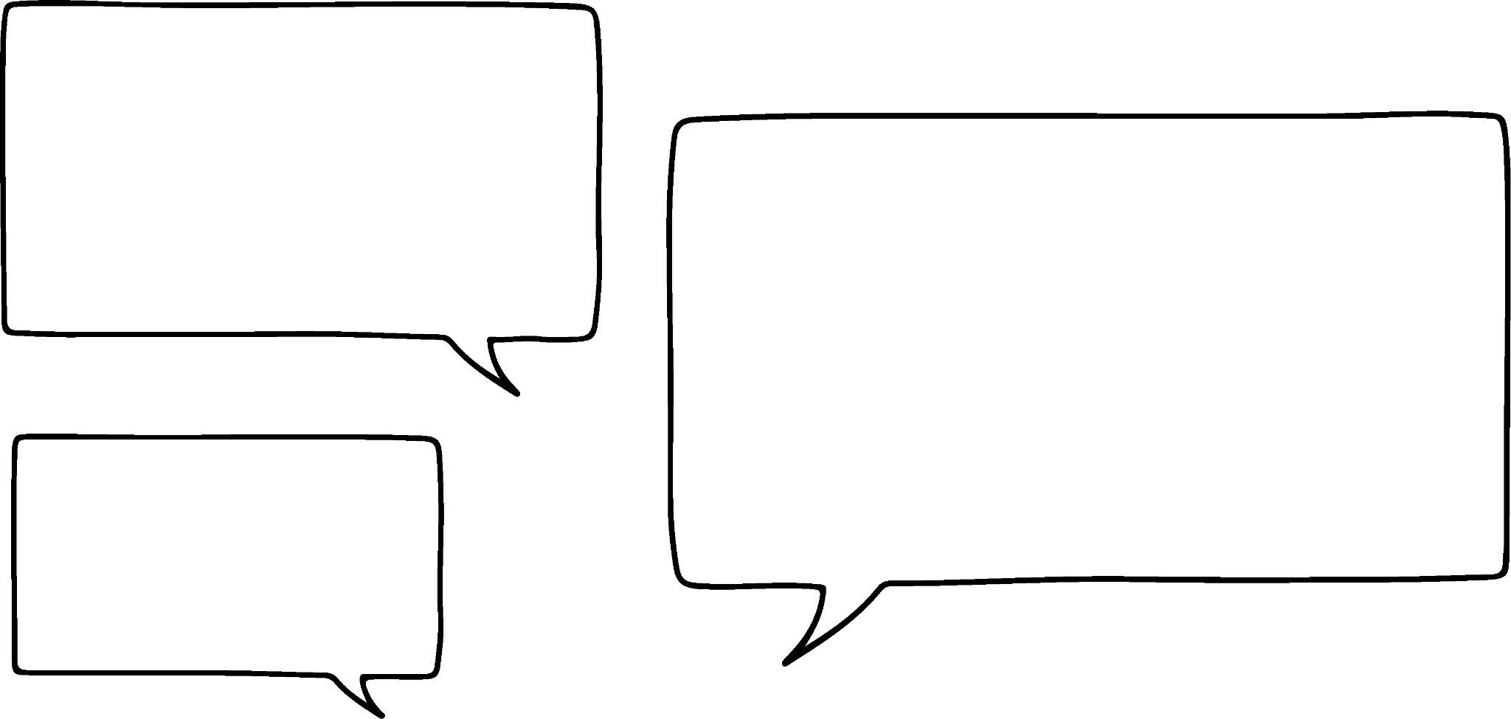
Plotting coordinates in all four quadrants
Alex plots the coordinate (4, 3)
✖
That’s four right, three up.
What has Alex done wrong?
(4, 3)
✖
It has to be four right and three up, from the origin.
More accurate language is four in the positive x-direction and three in the positive y-direction , from the origin.
The origin (0, 0)

Slide 7
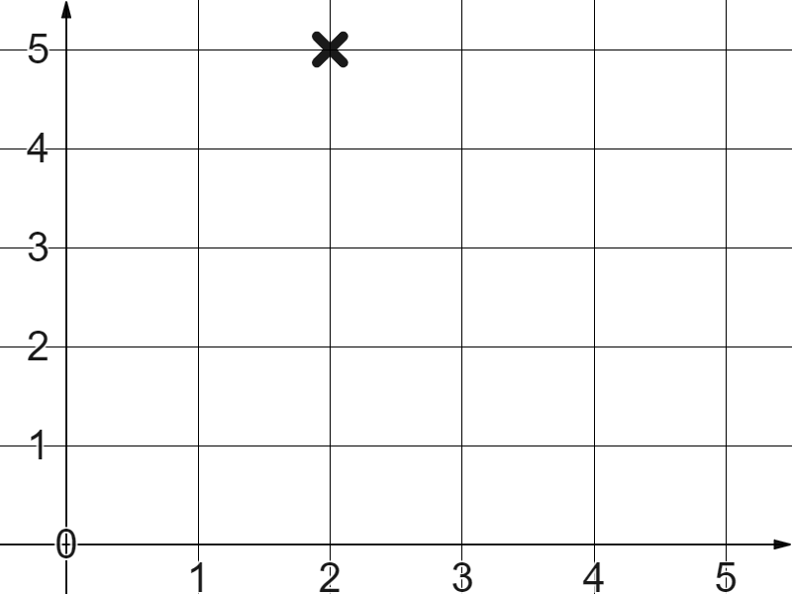

Plotting coordinates in all four quadrants
Which sentence best describes this coordinate?
two right, five up
two in the x-direction, five in the y-direction
five in the x-direction, two in the y-direction
two in the positive x-direction, five in the positive y-direction

Slide 8
Plotting coordinates in all four quadrants
Alex says…
That’s the coordinate (5 1)
✖
Alex has made more than one mistake. What are they?
Coordinates are written in the form (x, y) with a comma in between.
In this case the x coordinate is 1, the y coordinate 5, so the coordinate is (1, 5).

Slide 9
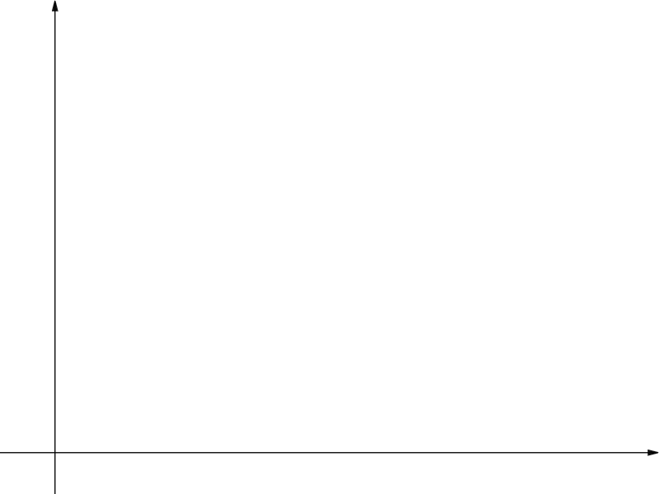

Plotting coordinates in all four quadrants
Aisha says…
I know the missing coordinates.
8
✖
✖
✖
(2, 8)
(7, 8)
(11, 8)
What has she noticed?
They all share the same y coordinate of 8

Slide 10
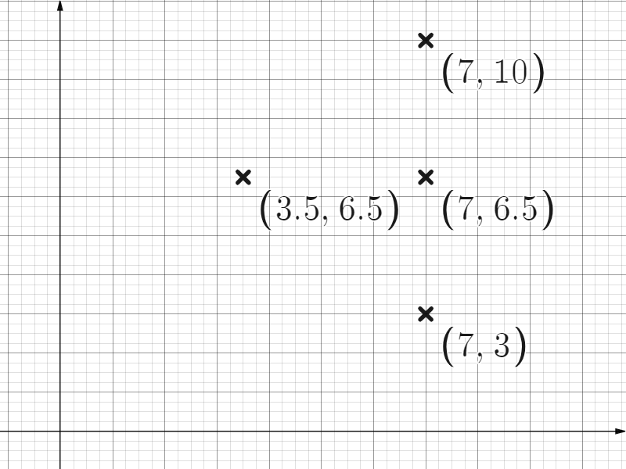
Plotting coordinates in all four quadrants
What are the the missing coordinates?
There is a common x coordinate for three of the coordinates.
There is a common y coordinate for two of them.

Slide 11
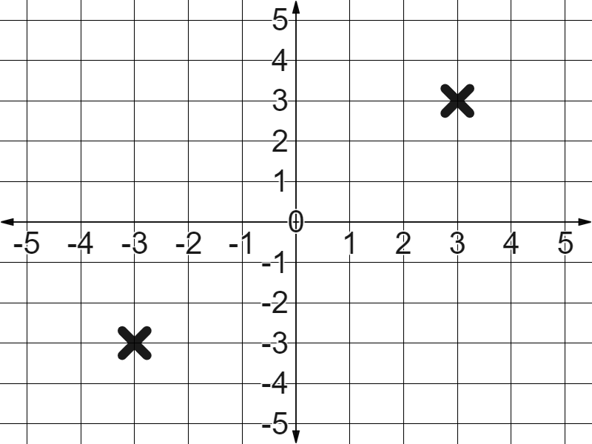
Plotting coordinates in all four quadrants
What is the difference between these two coordinates?
(3, 3)
One is three in the positive x-direction and three in the positive y-direction from the origin. The coordinate (3, 3)
One is three in the negative x-direction and three in the negative y-direction from the origin. The coordinate (−3, −3)
(−3, −3)

Slide 12
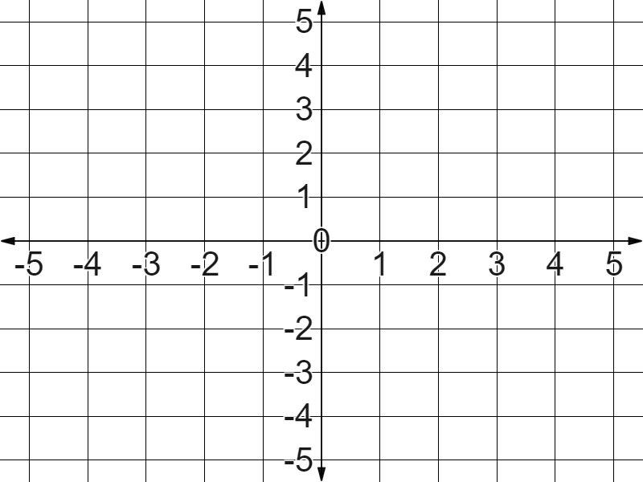
Plotting coordinates in all four quadrants
Which is true of this coordinate?
✖
(−4, 5)
positive x-direction, positive y-direction
positive x-direction, negative y-direction
negative x-direction, positive y-direction
negative x-direction, negative y-direction

Slide 13
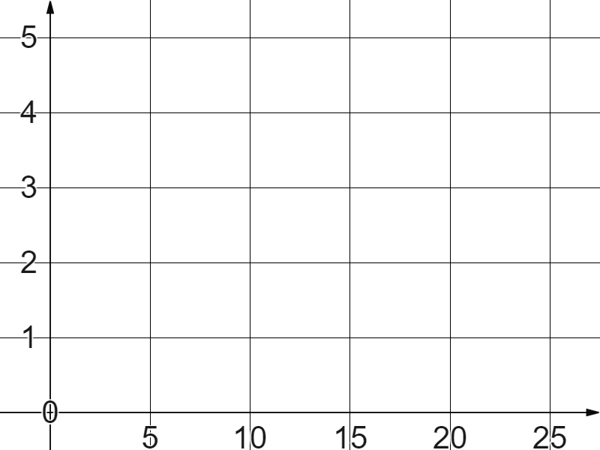
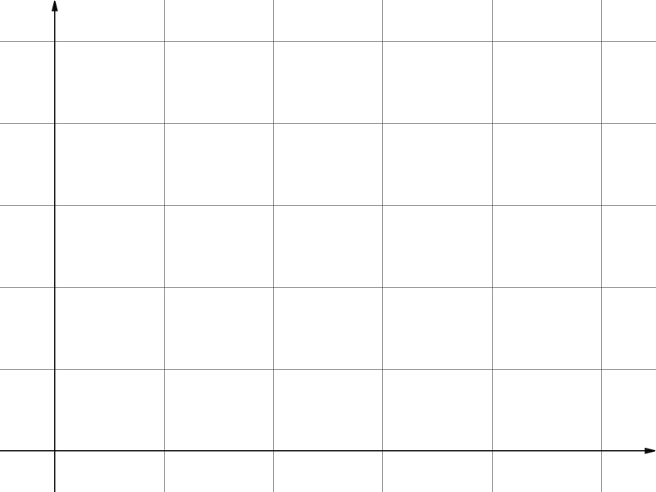
Plotting coordinates in all four quadrants
If coordinate A is (10, 5) what is coordinate B?
✖
A
(9, 4)
✖
B
(5, 4)
(1, 4)

Slide 14
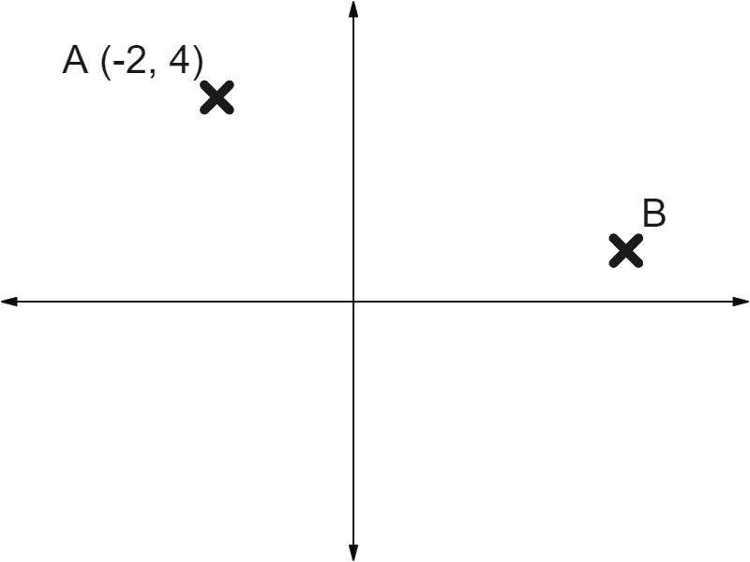
Plotting coordinates in all four quadrants
Estimating coordinates is also a useful skill.
If coordinate A is (−2, 4) what do we know about coordinate B?
Both the x and y coordinates are positive.
The y coordinate is less than 4
We can estimate the x coordinate to be greater than 2 because B is further from the y-axis than A.

Slide 15
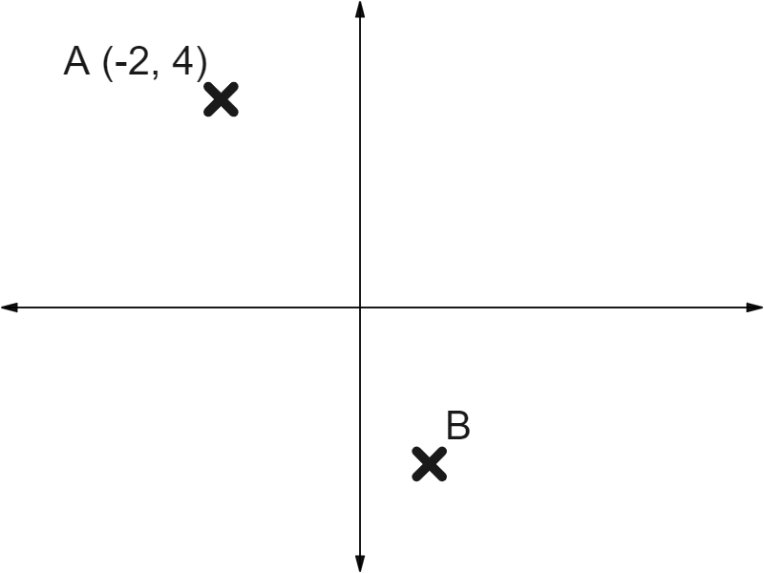
Plotting coordinates in all four quadrants
Which of these is a good estimate for coordinate B?
Too far in the negative y-direction.
(1, −7)
(1, −3)
(3, −5)
Too far in the positive x-direction.

Slide 16
Plotting coordinates in all four quadrants
1) Plot the coordinates:
(5, 2)
(1, −1)
(−2, 3)
(−3, −4)

Slide 17
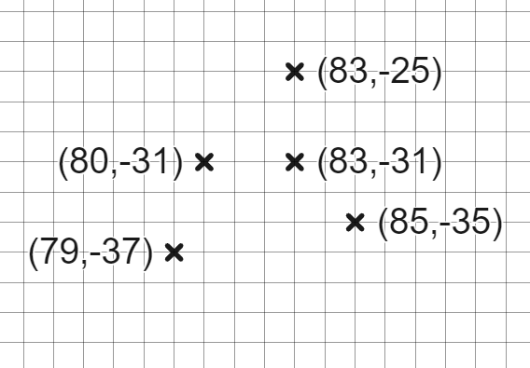
Plotting coordinates in all four quadrants
2) What are the the missing coordinates?

Slide 18
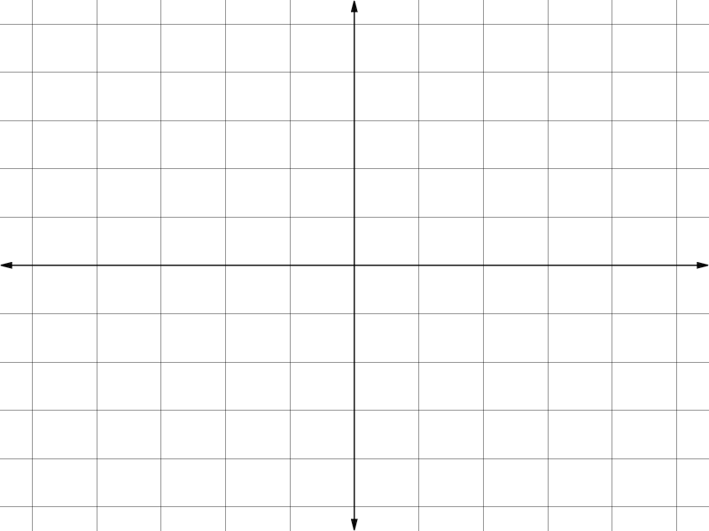
a) If coordinate A is (−6, 4) what are B and C?
b) If coordinate C is (−6, −40) what are A and B?
c) If coordinate B is (−40, 0) what are A and C?
Plotting coordinates in all four quadrants
3) Solve these axes scale problems.
A
✖
B
✖
C
✖

Slide 19
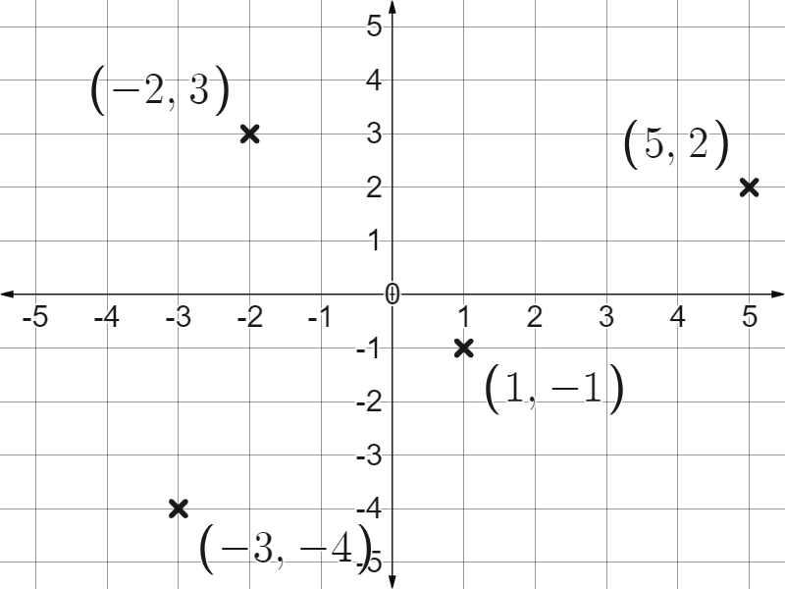
Plotting coordinates in all four quadrants
1) Plot the coordinates:
(5, 2)
(1, −1)
(−2, 3)
(−3, −4)

Slide 20

Plotting coordinates in all four quadrants
2) What are the the missing coordinates?
Scale of 1 in the x-direction.
Scale of 2 in the y-direction.

Slide 21
a) If coordinate A is (−6, 4) what are B and C?
b) If coordinate C is (−6, −40) what are A and B?
c) If coordinate B is (−40, 0) what are A and C?
Plotting coordinates in all four quadrants
3) Solve these axes scale problems.
B (−12, 0)
C (−9, −8)
A
✖
B
A (−4, 20)
B (−8, 0)
✖
C
✖
x coordinates of −30 and −20 but we don’t know the scale on the y-axis.

Slide 22
Checking and securing understanding of plotting coordinates
Plotting coordinates in all four quadrants
Coordinate problem solving with shapes

Slide 23
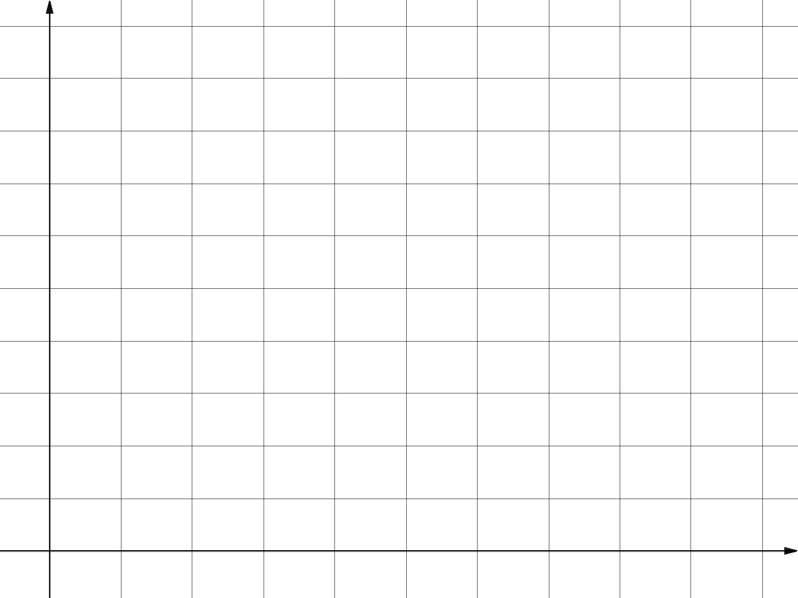
Coordinate problem solving with shapes
Two identical squares.
If coordinate B is (12, 12) then how do we know coordinate A?
B (12, 12)
✖
A
A (6, 6)
It’s (6, 6) because it’s half the distance in both the x and y directions.
✖

Slide 24
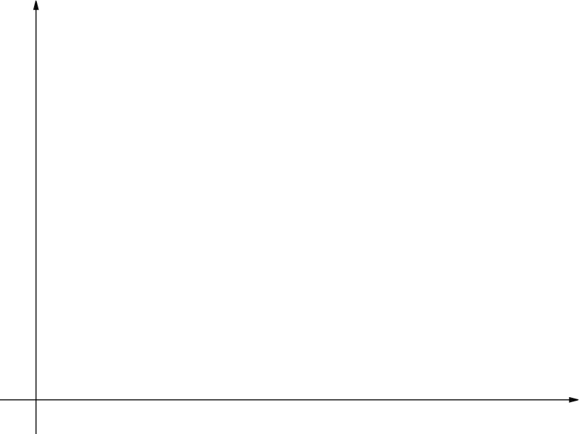
Coordinate problem solving with shapes
Three identical rectangles.
If coordinate A is (8, 10), how do we find B and C?
✖
C (24, 30)
C
✖
B
Repeat the same “8 in the x-direction, 10 in the y-direction” journey.
B (16, 20)
✖
A (8, 10)

Slide 25
Coordinate problem solving with shapes
What are the coordinates of point B?
Three times the journey to (5, 0.4)
(15, 1.2)
B
1.2
✖
(15, 12)
0.8
0.4
✖
A (5, 0.4)
(9, 6)
5
10
15

Slide 26
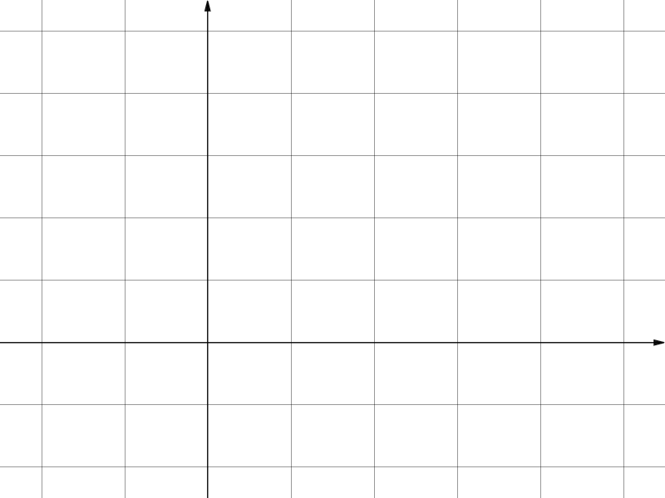
Coordinate problem solving with shapes
If we know that this is a square with coordinate A (3, 0) and coordinate B (0, 0) do we know all four coordinates?
C
D
C (0, 3)
D (3, 3)
✖
✖
Yes. All lengths of 3 parallel to the x and y axes.
✖
✖
B
A
B (0, 0)
A (3, 0)

Slide 27

Coordinate problem solving with shapes
Do we have enough information to know all the coordinates of this square?
D
D (2, 4)
(−1, 3)
✖
1
−1
C
✖
3
3
Yes. This 3 and 1 movement between the vertices is repeated.
✖
1
A (3, 1)
✖
3
B (0, 0)
B

Slide 28
Coordinate problem solving with shapes
If this is a rectangle can we find the coordinate of D?
C (36, 56)
8
✖
−6
6
Yes. The journey from B to C must be the exact same journey as A to D.
D (44, 50)
2
8
✖
✖
B
(34, 50)
−6
6
2
✖
Yes. The journey B to A must also be the same as journey C to D.
A (42, 44)

Slide 29
Coordinate problem solving with shapes
On this rectangle which journeys will match on both distance and direction?
D
✖
A to B and C to D
C
✖
Same distance, different direction.
B to A and C to D
✖
A
✖
B
C to B and D to A

Slide 30
Coordinate problem solving with shapes
If this is a rectangle what are the coordinates of point C?
A (40, 81)
(20, 63)
5
D
(15, 72)
−14
(20, 58)
5
B
(45, 67)
−14
(10, 58)
C(20, 58)

Slide 31
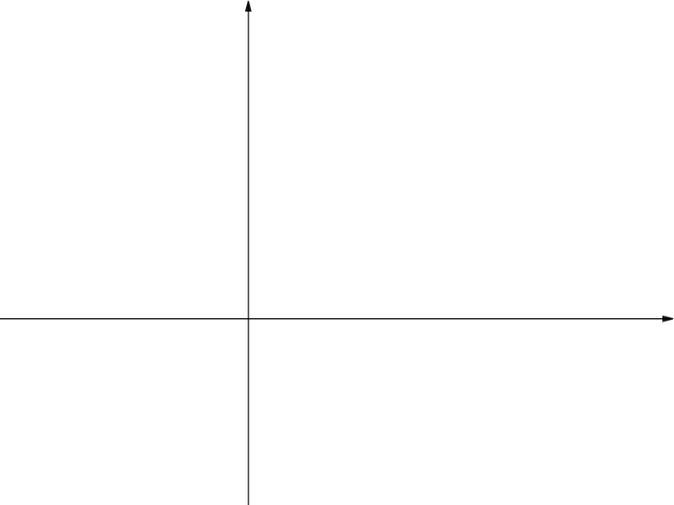
Coordinate problem solving with shapes
1) Find the missing coordinates.
a) Three identical squares.
A (9, 9)
✖
✖
B
✖
✖
C
D

Slide 32
Coordinate problem solving with shapes
1) Find the missing coordinates.
b) Four identical rectangles.
✖
E
✖
D (2, 7)
✖
A
✖
✖
B
C

Slide 33
Coordinate problem solving with shapes
2) a) Find the missing coordinates of this square.
C
✖
D
✖
✖
B (0, 0)
✖
A (5, −2)

Slide 34
Coordinate problem solving with shapes
2) b) Find the missing coordinates of these identical rectangles.
F (8, 34)
G (22, 37)
✖
✖
✖
C (27, 19)
B (−5, 11)
✖
D (30, 5)
✖
✖
✖
E (16, 2)
A (−2, −3)

Slide 35
Coordinate problem solving with shapes
1) Find the missing coordinates.
a) Three identical squares.
A (9, 9)
✖
✖
B (4.5, 4.5)
D (0, −4.5)
✖
✖
C (−4.5, −4.5)

Slide 36
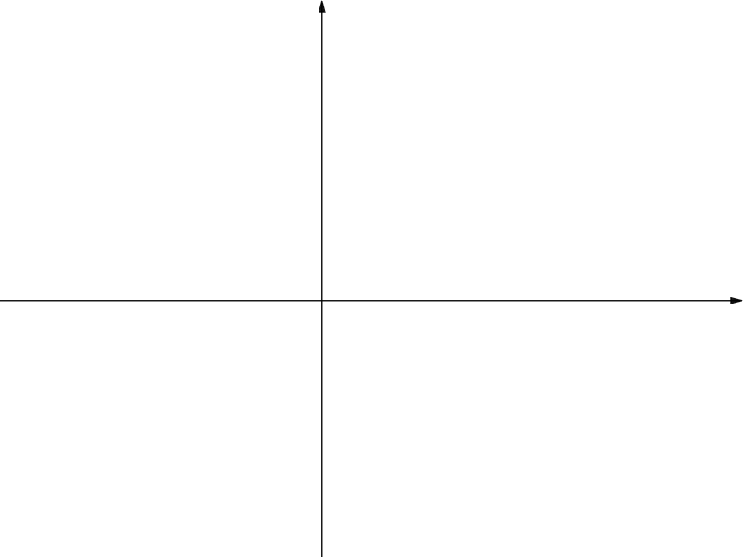
Coordinate problem solving with shapes
1) Find the missing coordinates.
✖
b) Four identical rectangles.
2
E (9, 9)
7
✖
D (2, 7)
−7
−2
−2
✖
A (−9, −2)
A
(−2, −7)
(0, −7)
✖
✖
B
C

Slide 37
Coordinate problem solving with shapes
2) a) Find the missing coordinates of this square.
The +5 in the x-direction and −2 in the y-direction becomes +2 in the x-direction and +5 in the y-direction to find C.
C (2, 5)
C
✖
D
D (7, 3)
✖
5
5
2
✖
This +2 in the x-direction and +5 in the y-direction is the same for A to D.
B (0, 0)
2
✖
A (5, −2)

Slide 38
Coordinate problem solving with shapes
2) b) Find the missing coordinates of these identical rectangles.
F (8, 34)
G (22, 37)
✖
✖
3
14
The short lengths are related by…
3
C (27, 19)
✖
3
B (−5, 11)
14
−14
✖
D (30, 5)
✖
✖
✖
E (16, 2)
A (−2, −3)

Slide 39
Checking and securing understanding of plotting coordinates
We can plot coordinates in all four quadrants and identify the scale of unlabelled axes if given a coordinate. It is possible to estimate a coordinate even when we don’t have axis labels or grid lines.
We can carefully consider the journey between vertices of shapes like squares and rectangles to find missing vertices.

Slide 40

© Oak National Academy 2023.
Produced in partnership with Mathematics in Education and Industry.
Licensed on the Open Government Licence v3.0, except where otherwise stated. See Oak terms and conditions.

